Slide 1
Real Estate Sales Analysis
2001-2021

Slide 2
Contents
Problem Statement
Review of literature
Metadata
Methodology
Interpretation of results
Conclusion

Slide 3
Problem Statement
Conduct a comprehensive descriptive analysis of real estate trends spanning from 2001 to 2021, focusing on understanding historical patterns, identifying key drivers of market dynamics, and extracting actionable insights for stakeholders in the real estate industry.
Key Questions to Address:
What are the overall trends and patterns in real estate prices and market activity over the past two decades?
How do real estate trends vary across different regions, property types, and market segments?
Which factors have had the most significant impact on real estate prices and market dynamics during this period?

Slide 4
Review of Literature
The direction of the study has been influenced by a number of Government reports, research papers from Journals, guidelines, industry reports and legal compliances. An extensive review of literature related to the study help in developing the broad conceptual basis for the research. A large number of widely reputed journals, Conference papers, published, Consultancy and industry reports of world renowned firms and Government guidelines constituted the main reference material of the study.
The literature Review of the study has been structured in the following way
Real Estate in General –Introduction
Housing and Urban development
Real Estate Pricing
Valuation of Real Estate
Buying Behavior.
Research gap.

Slide 5
Metadata
The Office of Policy and Management maintains a listing of all real estate sales with a sales price of $2,000 or greater that occur between October 1 and September 30 of each year. For each sale record, the file includes: town, property address, date of sale, property type (residential, apartment, commercial, industrial or vacant land), sales price, and property assessment.
Rows – 1.05M
Columns – 14
Column Name | Description | Type
Serial Number | Serial number | Number
List Year | Year the property was listed for sale | Number
Date Recorded | Date the sale was recorded locally | Date & Time
Town | Town name | Plain Text
Address | Address | Plain Text
Assessed Value | Value of the property used for local tax assesment | Number
Sale Amount | Amount the property was sold for | Number
Sales Ratio | Ratio of the sale price to the assessed value | Plain Text
Property Type | Type of property including: Residential, Commercial, Industrial, Apartments, Vacant, etc | Plain Text
Residential Type | Indicates whether property is single or multifamily residential | Plain Text
Non Use Code | Non usable sale code typically means the sale price is not reliable for use in the determination of a property value. See attachments in the dataset description page for a listing of codes | Plain Text
Assessor Remarks | Remarks from the assessor | Plain Text
OPM remarks | Remarks from OPM | Plain Text
Location | Lat / lon coordinates | Point

Slide 6
Methodology
Type of data we used here is from the year 2001 till 2021. Dataset has over 1 Million rows of data across different features. Dataset had missing values, null values and outliers as well.
Following is the approach used to address the issues in dataset
Price variable has outliers, these have been handled using Percentile Method
As Town variable has 170 unique values we can use topn method to get analysis for top most town
Grouping the year variable with combination of different variables to find the trends and patterns within them
Finding the correlation between variables
Analyzing Year Wise trend for price variables

Slide 7
Interpretation of results

Slide 8
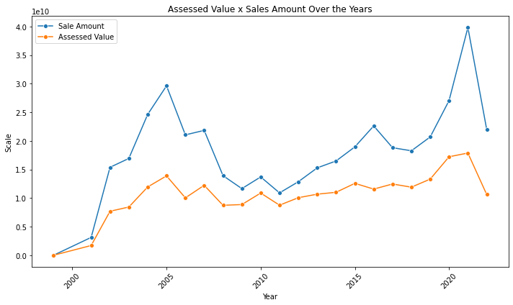
What are the overall trends and patterns in real estate prices and market activity over the past two decades?
Sale Amount was seen increasing till year 2005, but then after it falls drastically till 2011. It was seen highest in the year 2021.
Assessed Value follows the same pattern throughout the years. It can be seen these two features are positively co-related

Slide 9
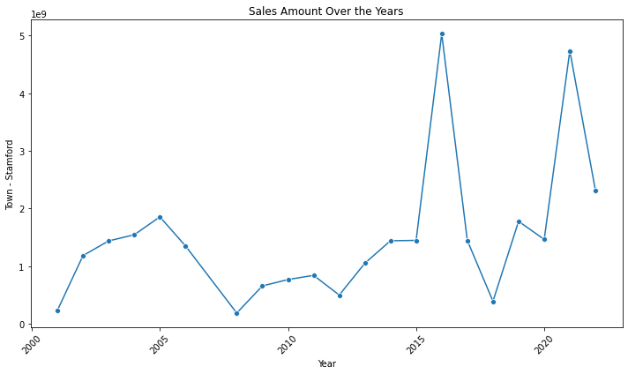
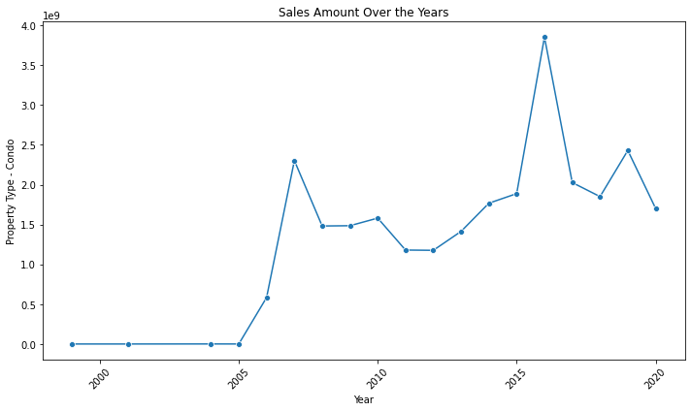
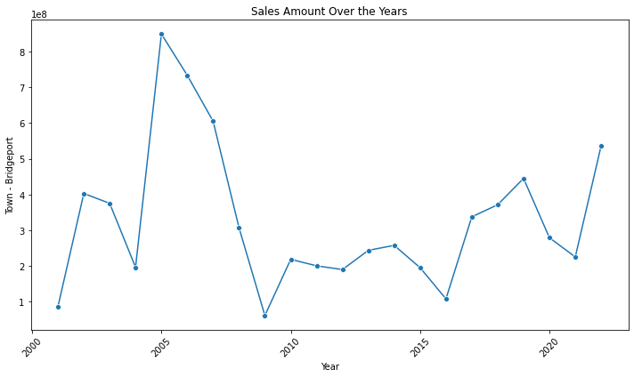
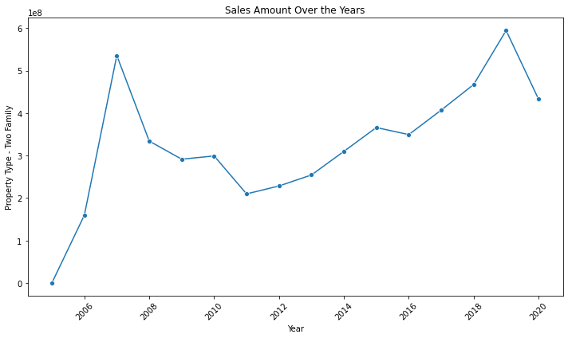
Cont..
Following are the few examples of Year Wise Price Trend for Town & Property Type

Slide 10
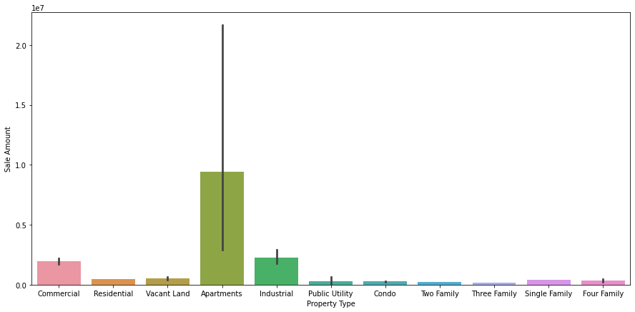
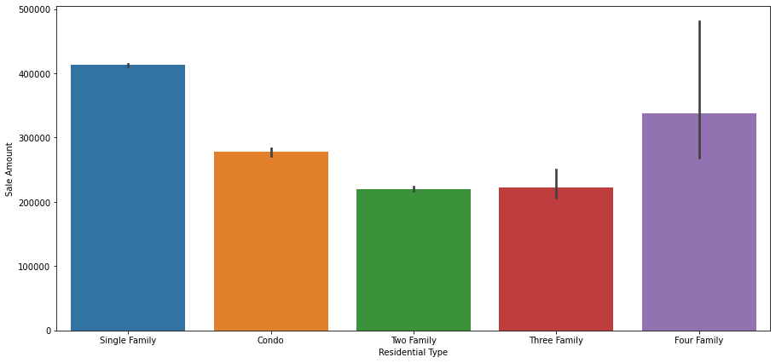
How do real estate trends vary across different regions, property types, and market segments?
Assessed Value |  |  |  | Sale Amount
 | min | max | mean | sum | min | max | mean
Town
Greenwich | 10150.0 | 122935400.0 | 1.350363e+06 | 2.237822e+10 | 15000.0 | 181700000.0 | 2.140154e+06
Stamford | 8610.0 | 114924210.0 | 4.150307e+05 | 1.407535e+10 | 15000.0 | 395500000.0 | 9.339519e+05
Norwalk | 8830.0 | 99691020.0 | 3.617318e+05 | 9.016888e+09 | 15000.0 | 157000000.0 | 6.283171e+05
Westport | 9700.0 | 78206200.0 | 8.767160e+05 | 8.445405e+09 | 20000.0 | 130000000.0 | 1.472050e+06
Fairfield | 9100.0 | 36390830.0 | 4.630708e+05 | 7.794871e+09 | 17500.0 | 93000000.0 | 7.343645e+05
Greenwich, Stamford, Norwalk, Westport, Fairfield are the top 5 towns with highest average Sale Amount
In Property Type Variable Apartment have the highest Sale Amount, followed by Industrial
Residency Type highest Sale Amount can be seen for Single Family followed by four family and condo

Slide 11
Which factors have had the most significant impact on real estate prices and market dynamics during this period?
Based on analysis, it is seen that market dynamics depends on various factors. The factors are,
Geography (Town)
Property Type or Residency Type
Year

Slide 12
Conclusion
The analysis shows that there can be various factors that might affect the Sale Amount of the property. Trends shows that Sales Amount and Assessed Value has been drastically dropped across the years, it can we seen high at initial years and then again at the end of the second decade
Property type and Residency type also affects the price of the property, data shows Industry, Apartments and single family type has highest prices amongst others
Geographical location also plays major role in affecting price. In real life case it depends on the market, economy, people etc.

Slide 13
Reference
https://data.ct.gov/Housing-and-Development/Real-Estate-Sales-2001-2021-GL/5mzw-sjtu/about_data
http://macl-ustm.digitallibrary.co.in/bitstream/123456789/2497/13/13_chapter2.pdf

